Slide 1
CENTERSTONE SCHOOL-BASED CLINICAL TRAINING SERIES
Telehealth 101
Policy · Scheduling · Intervention

Slide 2
PUTTING IT INTO PRACTICE
Welcome to Today's Training
In this session we will explore how to deliver effective, ethical, and engaging telehealth services. We will cover Centerstone policy and documentation standards, practical technology tips, and a curated set of resources and activities designed specifically for the telehealth environment.
Telehealth 101
This training includes interactive reflection and discussion, followed by a research-informed overview designed to serve as a takeaway and reference after the session.
Objectives — By the end of this training you will be able to:
01 Describe the clinical and practical benefits of telehealth service delivery.
02 Apply Centerstone telehealth policies, inclusion requirements, and consent procedures with confidence.
03 Document telehealth sessions accurately and completely in Avatar.
04 Navigate Zoom and session technology smoothly with clients.
05 Access and use a curated set of telehealth-specific therapeutic activities and resources.
Centerstone Clinical Training Series · June 2026

Slide 3
“
Why This Training Matters
Telehealth is not a lesser version of therapy — it is a different environment that requires intentional skill. How therapists show up in the telehealth space directly affects client engagement, trust, and clinical outcomes.
This training equips you with the policy knowledge, documentation skills, and creative tools to deliver care that is consistent, compliant, and clinically strong — regardless of whether your client is across the room or across town.
Strong telehealth practice reduces missed sessions, improves access to care, and supports therapist sustainability by creating predictable, structured workflows.
Same mission. Different medium. Same standard of care.

Slide 4
What We Cover Today
1
2
3
4
5
Benefits
Policy & Standards
Scheduling & Documentation
The Fun Stuff
Tips & Takeaways
Why telehealth works and what the research says
Centerstone procedures, inclusion, and consent
Topher's Telehealth Toybox, play therapy & family activities
Final guidance and next steps
Avatar requirements and documentation essentials
Centerstone Clinical Training Series · June 2026

Slide 5
The Benefits of Telehealth
What the research says — and what it means for your practice
Proven Quality of Care
Flexible Scheduling
Expanded Access
Countless studies over the last decade have consistently shown that telehealth provides quality of care on par with traditional in-person services. You are not compromising the work.
Telehealth allows secure, real-time communication with clients at times that fit both your schedule and theirs. Fewer barriers to attendance means fewer missed sessions.
You can provide services from your office, a client's home, or any secure location. Telehealth removes the constraint of physical location and opens care to clients who could not otherwise access it.
Telehealth does not replace in-person care — it extends it. More access. More consistency. More impact.

Slide 6
POLICY REFERENCE
Key Policy Standards
Centerstone Policy
Who telehealth serves
Outpatient clients who are unable to be seen in person, or who request telehealth and are deemed clinically appropriate.
Telehealth Services — 04.017.AM
Provider licensing requirement
Clients must be in the state where the provider or clinical supervisor is independently licensed. Out-of-state exceptions for school-based staff require Compliance approval.
Ethical and legal guidelines for telehealth are reviewed at hire and annually thereafter via Relias training.
Informed consent
All clients undergo an informed consent procedure — including signing the consent for treatment and reviewing emergency contact and safety protocols.
Clinical appropriateness is ongoing
Screening occurs at intake and throughout the treatment episode. Either the client or provider may determine that in-person sessions are more appropriate at any point.
See Policy: 04.017.AM Telehealth Services

Slide 7
Before the First Telehealth Session
Inclusion, screening, and informed consent — every time.
INCLUSION REQUIREMENTS
INFORMED CONSENT MUST INCLUDE
—
Client screened for clinical appropriateness at intake and throughout treatment.
—
Discussion of the use, risks, and benefits of telehealth.
—
Safety procedures and emergency contact protocols.
—
Enrollment is at the discretion of the provider and/or supervisory clinical staff.
—
Limits of confidentiality in the telehealth environment.
—
At any point the client or provider may determine in-person is more appropriate.
—
Routine and emergency contact procedures specific to the clinic.
—
Failure to comply with telehealth agreements may result in termination of telehealth appointments.
—
Photo ID verification at initial session if provider has not seen client face to face.
—
Referral generally follows a face-to-face intake. Some intakes may be conducted via telehealth under clinic manager guidance.
All staff — including support staff, THL/CM, therapists, and med providers — must attest to reviewing the telehealth SOP and clinic general policies.

Slide 8
Documentation — Initial Telehealth Session
Every telehealth encounter must be documented as such in Avatar — in full.
1
2
3
4
Verify Identity
Document Telehealth Discussion
Record Provider Location
Confirm Client Location
Request photo ID at the initial telehealth contact if you have not seen the client face to face prior to the visit.
Record that you discussed the use, risks and benefits of telehealth, as well as safety, emergency contact procedures, and limits of confidentiality.
Document your location in Avatar for every telehealth session.
Document the client's location — note specifically if they are not at their home address.
ID Verification
+
Consent Discussion
+
Location Documentation
=
Complete Initial Session
At the initial session: ID verification + consent discussion + location documentation. All three. Every time.

Slide 9
What Every Note Must Confirm
Date and time — Document the date and time of the session.
DOCUMENTATION
Ongoing Session Documentation
Session modality — Clearly state that the session was conducted via telehealth / televideo in Avatar.
Required at every subsequent telehealth session in Avatar.
Provider location — Your location at the time of session — required in Avatar.
Client location — Confirm client location in Avatar. If not at home, document the specific location.
Client phone number — Confirm the client's current phone number at the time of the session — every session.
Progress notes must contain evidence of each of these elements — not just session content.
Documentation is not optional and it is not an afterthought. It is part of the clinical and legal record of care delivered.

Slide 10
Navigating Zoom & Session Technology
Setting yourself and your client up for success before the session starts.
Connection First
Private Space
Camera Placement
Test your connection before sessions. A wired connection is more stable than Wi-Fi when possible.
Ensure your environment is private and HIPAA-compliant. Use a white noise machine or close doors to protect confidentiality.
Position your camera at eye level. Sit with light in front of you — not behind. What clients see matters.
Audio Check
Backup Plan
Set Expectations with Clients
Test your audio and ask clients to do the same before starting. Headphones reduce echo and background noise significantly.
Always have a backup plan — know your client's phone number and have a plan ready if the video connection fails.
Walk clients and families through how Zoom works at the first session. Do not assume they know. Simple orientation reduces friction every session after.
A smooth session starts before you press join.

Slide 11
TOPHER'S TELEHEALTH TOYBOX
Virtual Games & Activities
The Fun Stuff
Therapeutic Jeopardy — multiple topic templates
Memory / Concentration game online
skribbl.io — Free drawing and guessing game
Free Online Jigsaw Puzzles
A curated collection of virtual games, art tools, play therapy activities, and therapeutic resources — ready to use in session.
Uno Freak — Play Uno online
Digital UnGame — speaking cards
Go Fish, Crazy Eights, Checkers online
FREE Color Boardgame — create your own
Battleship, Connect 4, Tic Tac Toe — papergames.io
Virtual Manipulatives — tangrams, dominoes
Mancala Online
Simon Game online
Wheel of Names — any word list including emotions
Categories word game online
Centerstone Clinical Training Series Telehealth 101 · June 2026
These are tools — not tricks. Each one can be the entry point for meaningful clinical work.

Slide 12
More From the Toybox
Sand tray, puppets, art, scavenger hunts, and more.
Dr. Karen Fried Freebies
Online Art Tools
Therapeutic Videos
Free Online Dollhouse, Puppets, and Sand Tray — virtual versions of classic play therapy tools. Available at no cost.
Inspiral Web, Mandala Coloring, and Storyboard That — creative expression tools accessible directly from a browser.
Whole Child Counseling, Cosmic Kids Yoga, and Coping Skills for Kids — curated YouTube channels for in-session use.
Scavenger Hunts
Mad Libs & Creative Writing
Follow-Along Art
Primary Playground and MMHS Play Therapy scavenger hunts — free downloads that work well for engagement and assessment.
GlowWordBooks online Mad Libs — a low-barrier entry point for kids who resist direct conversation.
Origami jumping frog and origami fish tutorials — prep families with a single sheet of paper. Works across ages.
Send families the resource before the session. Prep creates buy-in.

Slide 13
PLAY THERAPY · TELEHEALTH
Activities to Try
Play Therapy in the Telehealth Room
Paper Plate Activity
Client collects items from home and stacks them on a plate held in one hand. Used to explore anxiety, worry, and coping. Works beautifully on video — no special materials needed.
Adapted activities that work through a screen — with materials families already have at home.
Me Tree
Client draws a tree with roots, trunk, branches, falling leaves, and a treetop — each part corresponds to a clinical prompt about identity, strengths, and growth. Drawing materials only.
Benevolent Experiences Ecomap
Client uses drawings, symbols, or objects from home to map protective factors and positive influences in their life. Flexible across ages and modalities.
Family Play Therapy
Involve the whole family — not just the identified client. Art and play bypass defenses, open communication, and create opportunities for insight that direct conversation cannot reach. Research by Gil, Lowenstein, and Sprunk supports this approach strongly.
Art & Drawing
Family Involvement
Strengths-Based
No Special Materials
The materials are wherever the client is. That is the advantage of telehealth.

Slide 14
A Few More Worth Bookmarking
CENTERSTONE CLINICAL TRAINING SERIES
Songs, mindfulness, and relational tools that meet clients where they are.
Telehealth 101 · June 2026
SONG · GROWTH MINDSET
MINDFULNESS · YOUTUBE
FEELINGS · COPING · YOUTUBE
EMOTIONS · ELEMENTARY–MIDDLE
Power of Yet
Cosmic Kids Yoga
Whole Child Counseling
Coping Skills for Kids
Sesame Street: Janelle Monáe — Power of Yet. A song about growth mindset that works with young children and opens conversation about effort and resilience.
YouTube channel with themed yoga and mindfulness stories for children. Works in session and as a between-session tool for families.
Therapeutic YouTube channel with videos on feelings, coping, and self-regulation designed for elementary through middle school.
Managing feelings and emotions for elementary and middle school — designed for in-session viewing and discussion.
Every resource here has been used in real sessions with real kids. They work.

Slide 15
Final Tips & Takeaways
Telehealth done well is telehealth done intentionally.
Policy is not paperwork.
Prep your space like you prep your session.
Engagement looks different through a screen.
Consent, documentation, and location confirmation protect your clients and your license. Do them every time.
Connection, privacy, camera, audio, and backup plan. Five minutes before saves the whole hour.
Use tools from the Toybox. Play is not optional in telehealth — it is often the only thing that works.
Complete your documentation in session.
Involve the family.
You are not alone in this.
Telehealth removes the commute barrier for caregivers. Use that. Family involvement improves outcomes — the research is clear.
Your team lead and Centerstone support are here. If something is not working — in your tech, your documentation, or your sessions — ask.
Telehealth and Eleos work together. Use the final minutes to confirm your note before you close the session.
Centerstone Clinical Training Series · Telehealth 101 · June 2026 · Topher Fuqua, LMFT

Slide 16
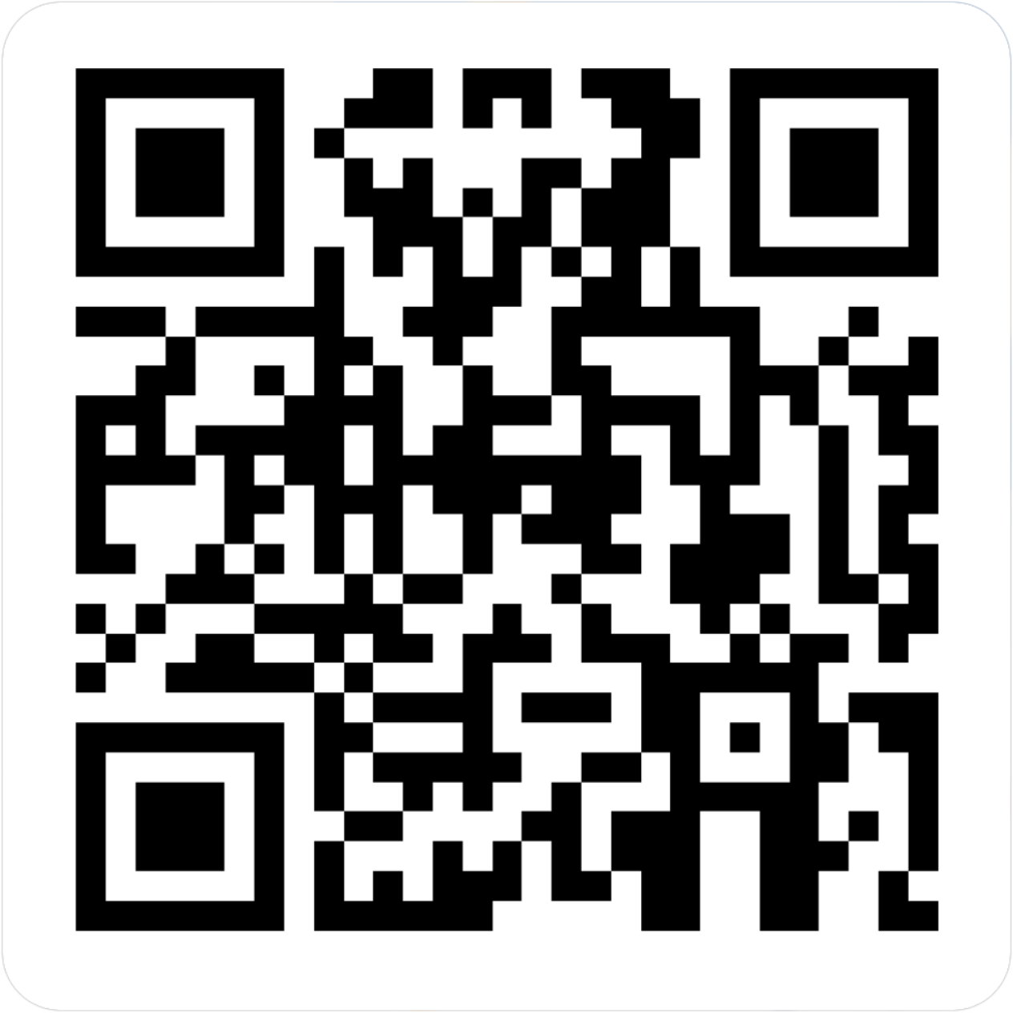
CENTERSTONE SCHOOL-BASED CLINICAL TRAINING SERIES
Telehealth 101
Completion of this survey is required for attendance verification for today’s training.
https://forms.office.com/r/EXVCQtPbti

